Slide 1

Restaurant Survey App
A complete solution to understand your customers and improve your restaurant

Slide 2
Team members
Mohamed Wael Mohamed Safwat
Omar Mohamed Hassan
Muhammed El-Hussein Taha
Omar Magdy Mahmoud
Abdelrahman Amr Ahmed

Slide 3
The Current Challenges
Restaurants struggle to collect real, honest feedback from customers.
Existing surveys are too long, annoying, or ignored.
Managers have no clear way to understand meal performance.
No insights into why some meals succeed and others fail.
Feedback is not structured for improvement.
Customers rarely feel encouraged to give reviews.

Slide 4
Our Smart Survey System
We created two connected apps:
User App: Simple, fast, enjoyable review experience
Admin App: Powerful analytics dashboard for restaurants
Together they:
Increase customer feedback
Improve meal quality
Give management real data to make decisions

Slide 5
How This System Improves Your Business
Increases customer engagement with loyalty points
Helps improve service quality
Allows ingredient-level insights (unique advantage)
Predicts trends using sentiment analysis
Reduces negative reviews on public platforms

Slide 6


Core Technologies Behind Our System
Flutter + GetX
Supabase
FL Charts (Admin)
Speech-to-text engine
Localization EN/AR

Slide 7
Why Flutssser?
Fast development (Hot Reload)
One codebase for iOS/Android
High performance & smooth UI
Beautiful UI with consistent rendering
Perfect for multilingual apps

Slide 8
FULL SIMULATED JOURNEY with our app

Slide 9
User App

Slide 10
User App – Designed for Simplicity
Fast review flow (under 1 minute)
Ingredient-level rating
Earn points for each review
Language switching EN/AR
Voice-to-text comments

Slide 11
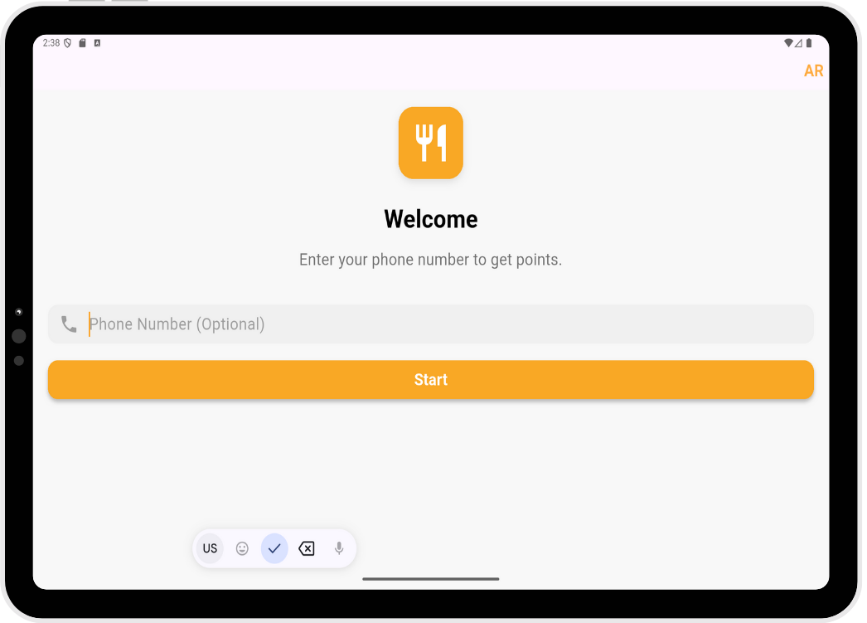
1. Welcome / Phone Registration
User opens the app
Sees welcome message and language toggle
Enters phone number (optional)
“Start” button begins the experience

Slide 12
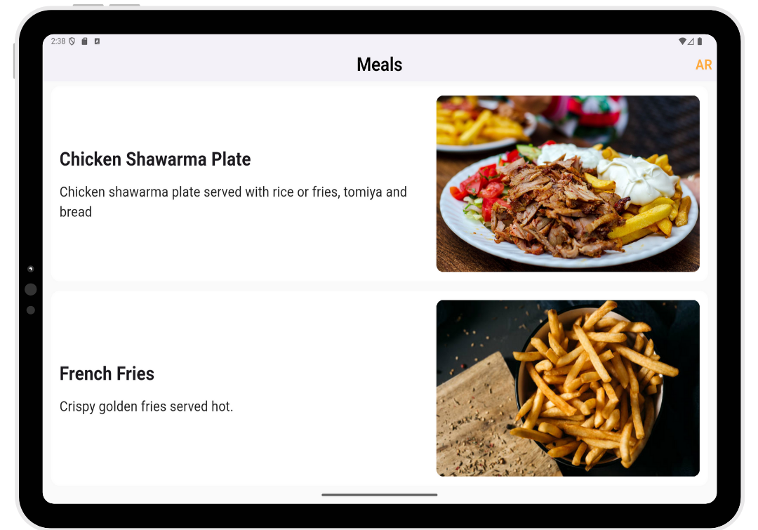
2. Choose a Meal to Review
List of available meals with images
Each card shows name + description
User taps any meal to review

Slide 13
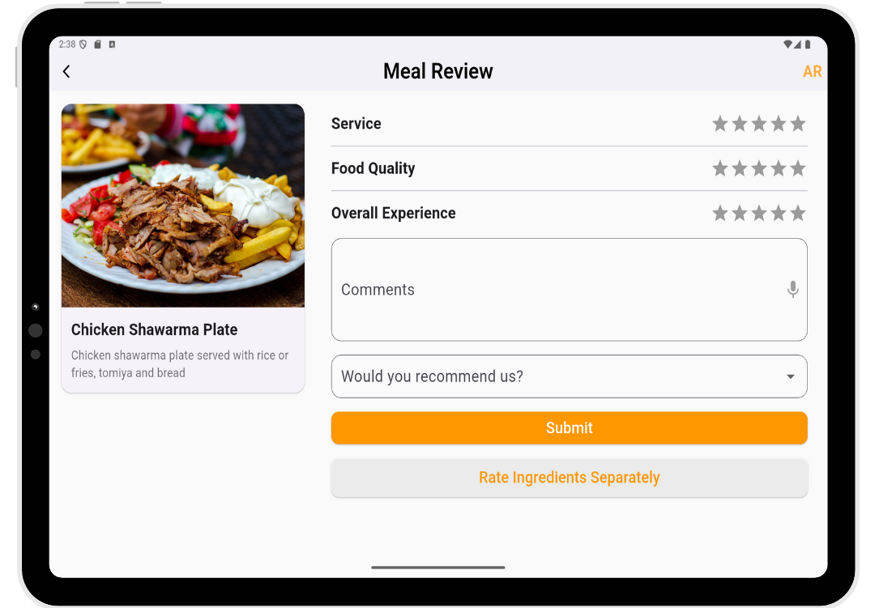
3. Rate Your Experience
Service rating
Food rating
Overall experience
Clear star system
Validation for missing ratings

Slide 14
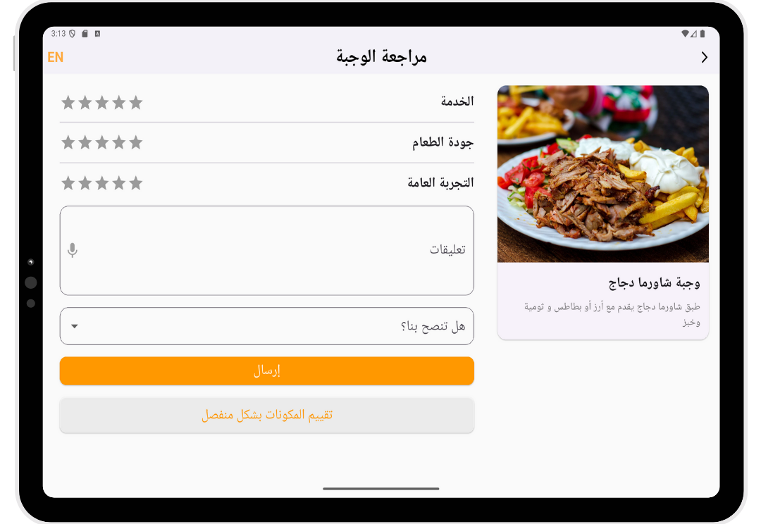
4. Write or Speak Your Feedback
User types or taps microphone
Speech recognized into text
Sentiment analysis validates comment
Prevents contradictory feedback

Slide 15
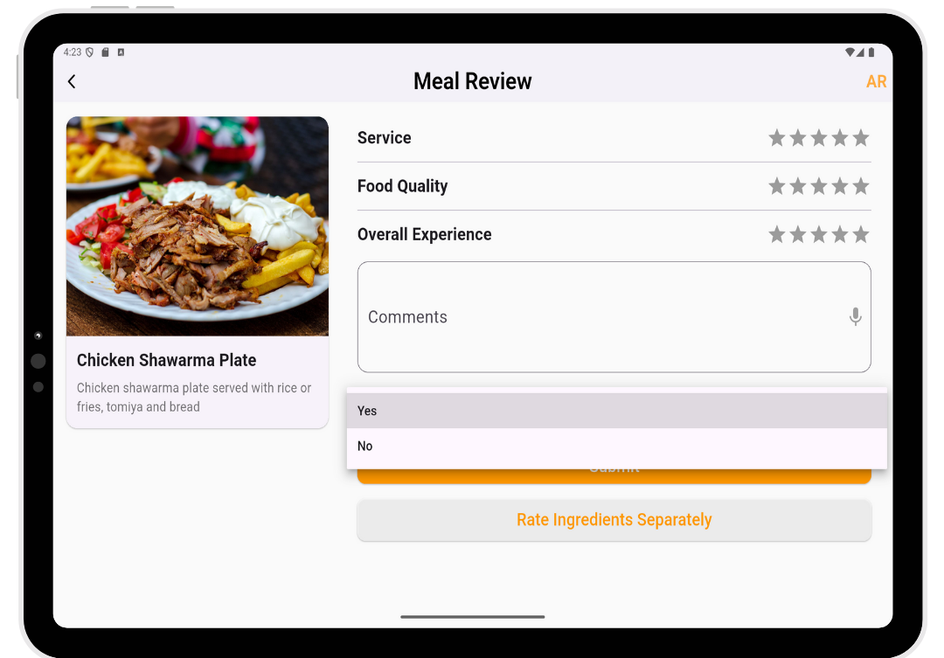
5. Would You Recommend Us?
Simple Yes/No toggle
Affects business analytics

Slide 16
6. Submit Review
App checks consistency
Shows thank-you dialog
Awards 10 points to the user
Returns to meals list

Slide 17
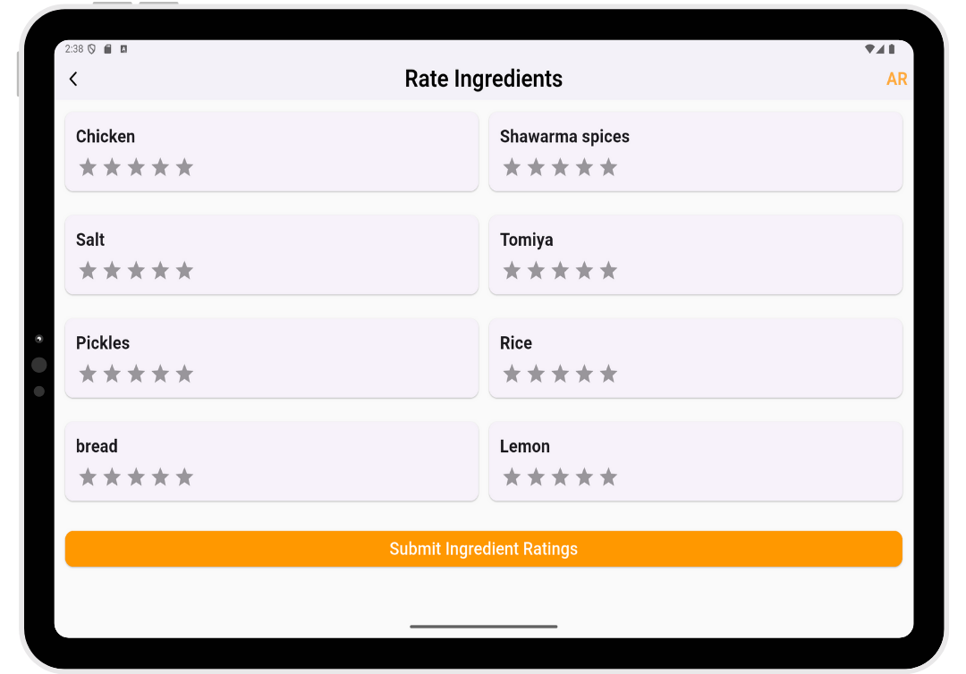
Optional: Rate Ingredients Separately
Grid of ingredients
Each with 5-star rating
Must rate all before submitting

Slide 18
Loyalty Points
+10 points per review
Points stored in database
Encourages repeated feedback

Slide 19
Admin App

Slide 20
Admin App – Control Center for Your Restaurant
Real-time reviews
Full analytics
Meal performance insights
Beautiful charts & dashboards

Slide 21
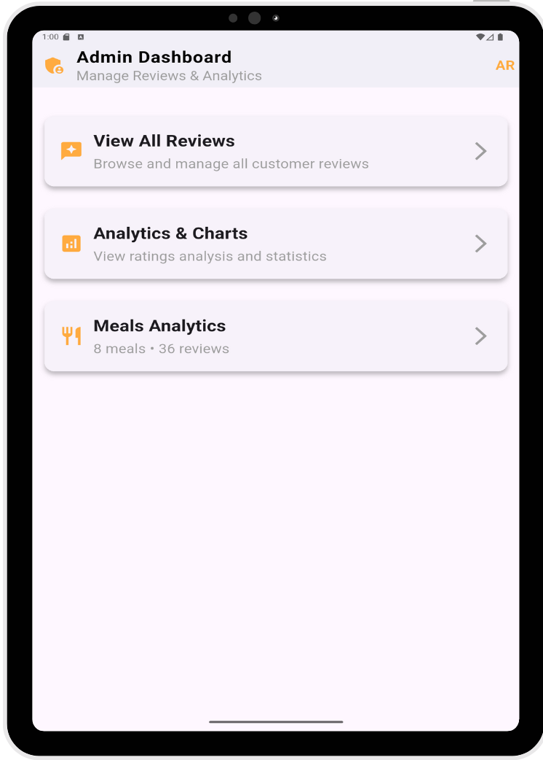
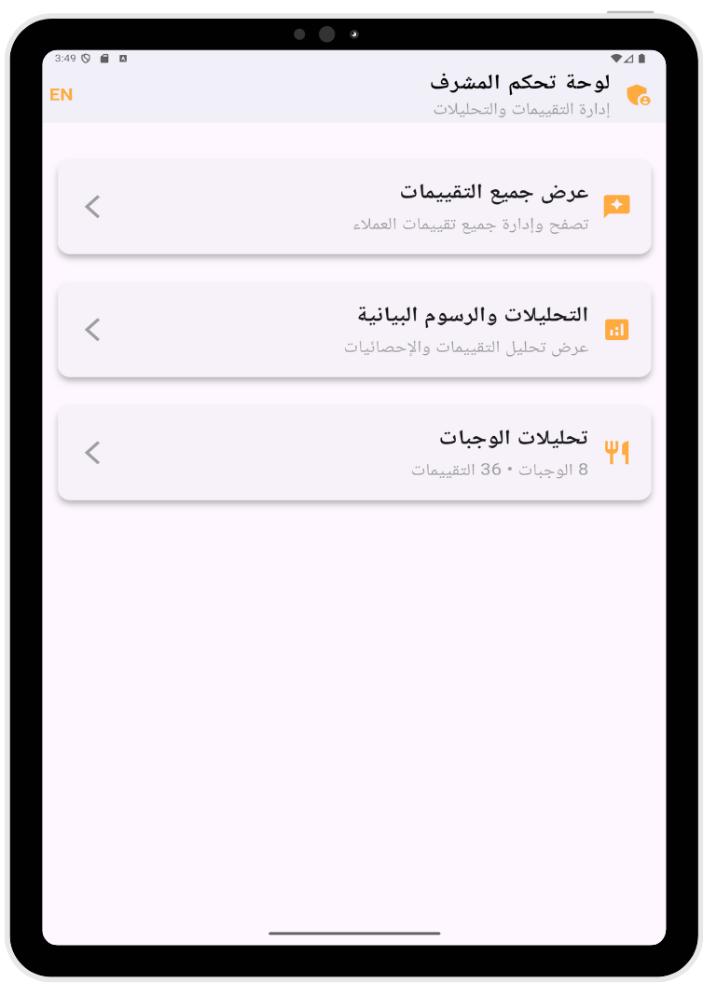
1. Main Dashboard
Total meals
Total reviews
Overall recommendation rate
Entry points to all features

Slide 22
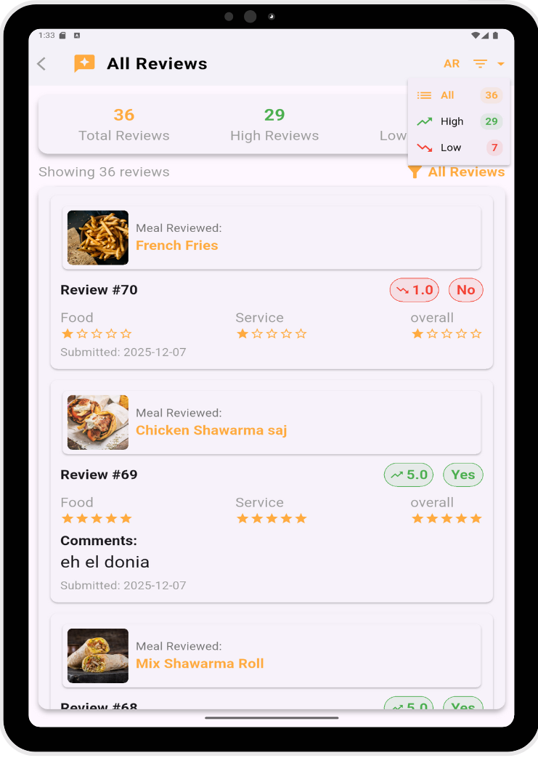
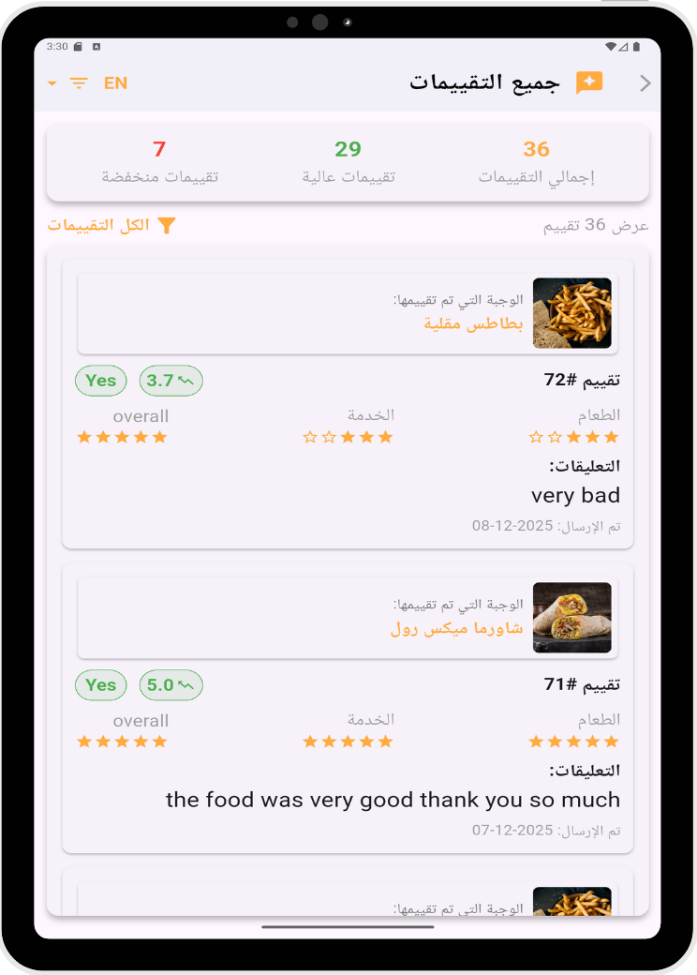
2. Review Management
All reviews with filter: All / High / Low
Colored badges for quick evaluation
Full rating breakdown
Comments + date

Slide 23
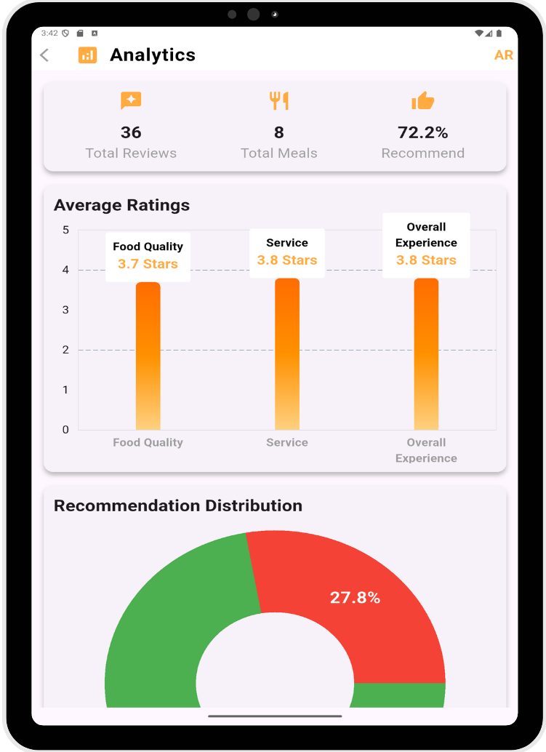
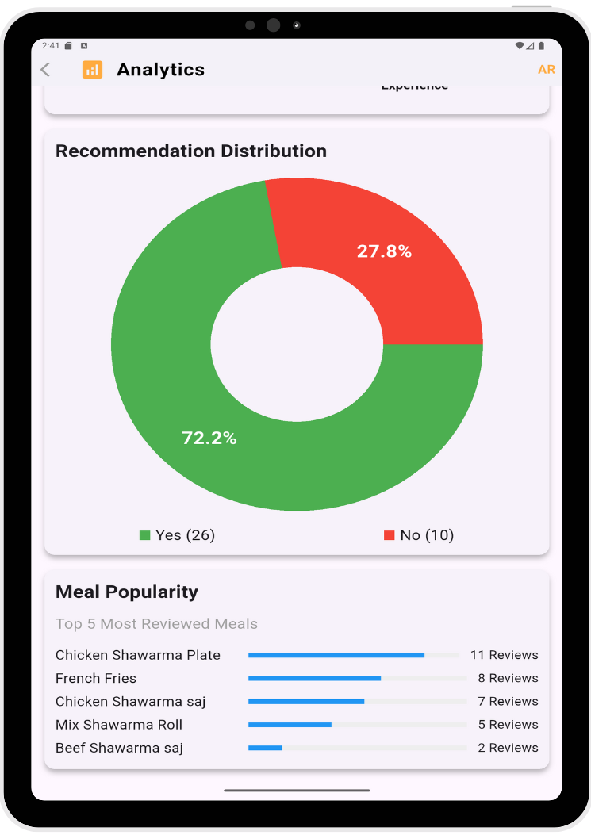
3. Global Analytics
Average ratings (Food/Service/Overall)
Pie chart of recommendations
Meal popularity chart
Fully interactive

Slide 24
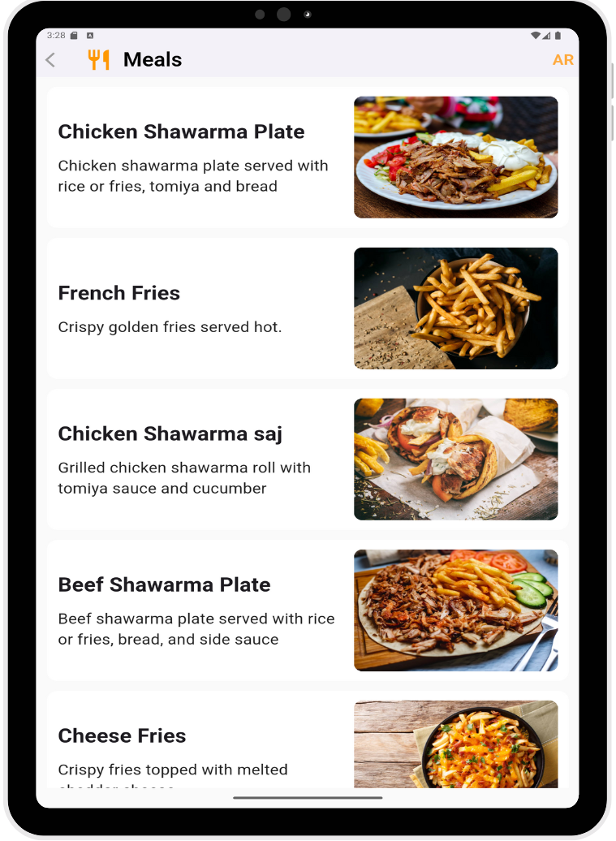
4. Meals Analytics
All meals displayed with images
Tap any meal to view its performance

Slide 25
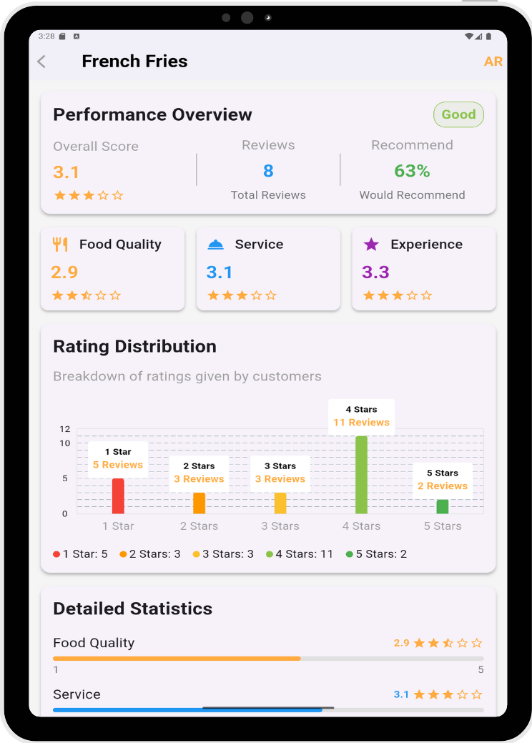
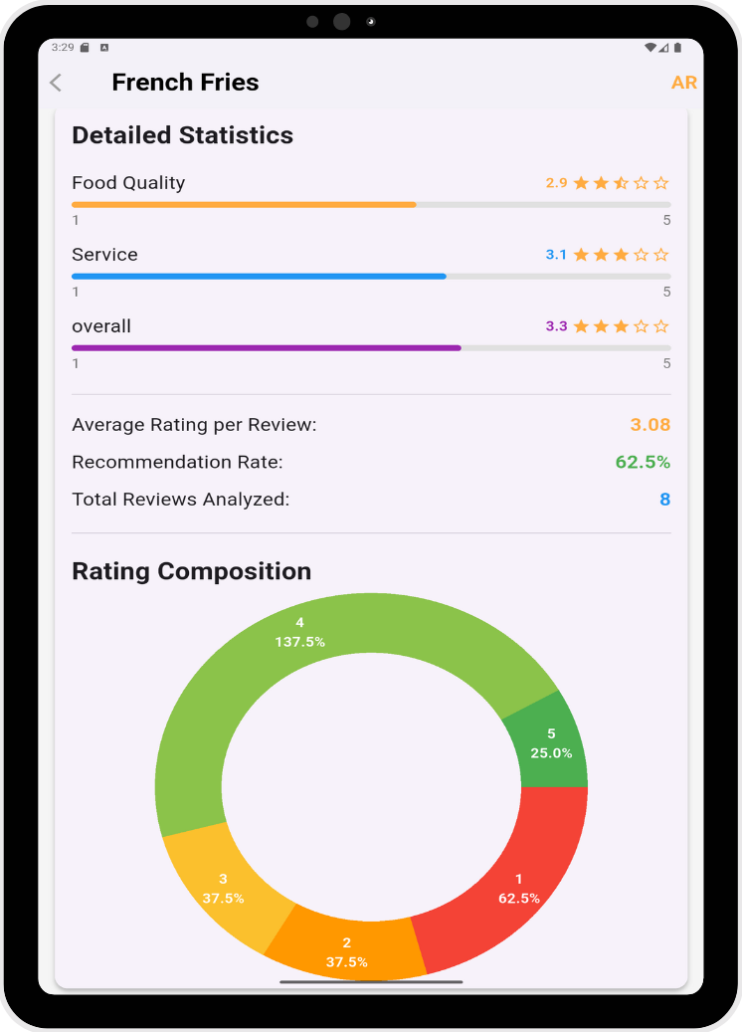
5. In-depth Meal Performance
Overall score
Food/Service/Experience averages
Rating distribution (1–5 stars)
Recommendation percentage
“Excellent / Good / Needs Improvement” indicator

Slide 26
Ready to Improve Your Restaurant?
Let us activate your restaurant today
Simple onboarding
Full support included

Slide 27
Thank you

